Slide 1

STAT4130J
Final Presentation
----Factors Affecting Lisbon House Prices
F2037002 520370910021 Cao Yanzhuo
F2037002 520370910024 Li Ang

Slide 2
Background

Slide 3
Background and Description
Objective: Develop a predictive model using regression analysis to analyze housing prices in Lisbon, Portugal, based on property attributes, benefiting buyers, sellers, investors, and policymakers.
Dataset: Utilizing a comprehensive dataset of residential properties in Lisbon, including essential variables like property condition, type, bedrooms, bathrooms, area, parking availability, and geographical coordinates.
Importance: Understanding the factors influencing housing prices is crucial in Lisbon's dynamic and competitive real estate market, enabling informed decision-making for various stakeholders.
Methodology: Applying linear regression techniques to construct a reliable predictive model, providing valuable insights into the key drivers of housing prices in Lisbon.

Slide 4
Design & Analysis

Slide 5
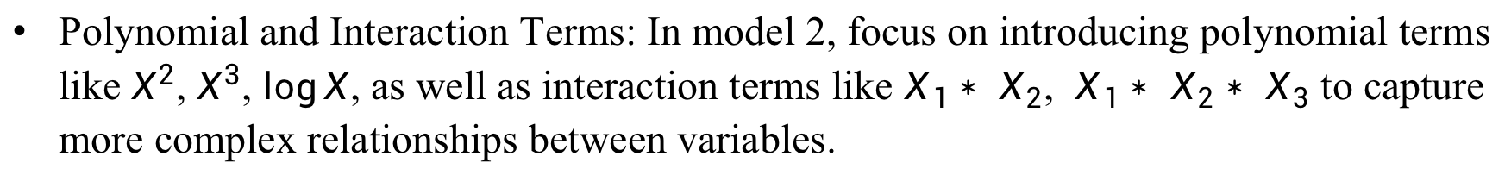
Design and Analysis
Data Processing and Collinearity: Thoroughly preprocess categorical and quantitative variables, identify potential collinearity among variables, and take necessary steps to resolve multicollinearity challenges by removing one of the correlated variables.
Linear Regression and Significance Analysis: Conduct linear regression on all variables, thoroughly examine the results, and exclude variables that do not demonstrate statistical significance to enhance the model's accuracy.
Residual Analysis and Outlier Handling: Analyze the Residuals vs Fitted values plot to check if the residuals meet the assumptions. Identify high leverage points and exclude outliers to refine the regression model iteratively.
Polynomial and Interaction Terms: In model 2, focus on introducing polynomial terms like $X^{2}$, $X^{3}$, $\log{X}$, as well as interaction terms like $X_{1}∗$ $X_{2}$, $X_{1}∗$ $X_{2}∗$ $X_{3}$ to capture more complex relationships between variables.

Slide 6
Results

Slide 7
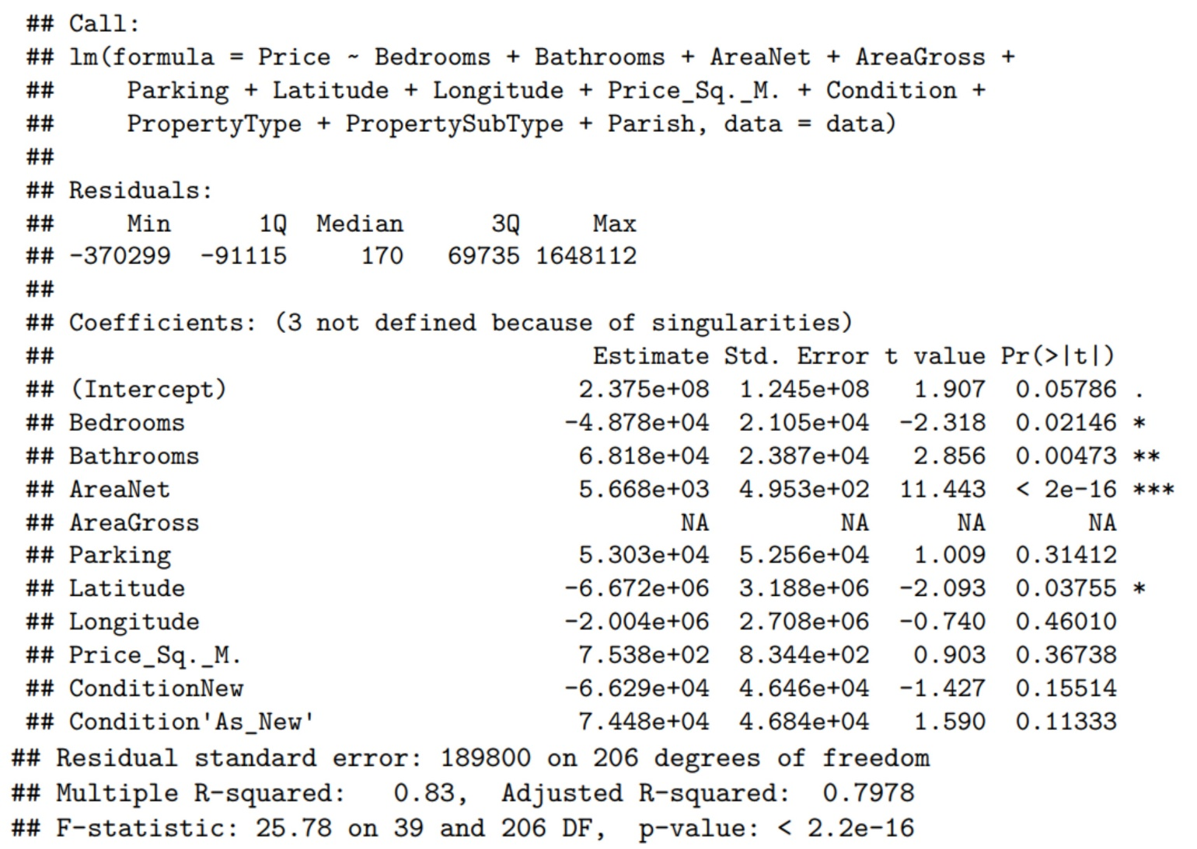
Results and Analysis of Model 1
Original regression of Model 1 (Hide some variables)

Slide 8
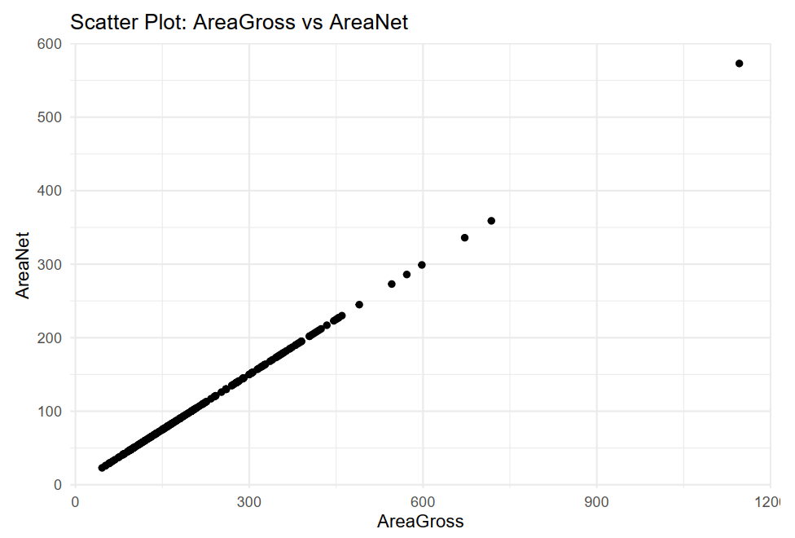
Results and Analysis of Model 1
Scatter plot: AreaGross vs AreaNet (Hide other scatter plots)

Slide 9
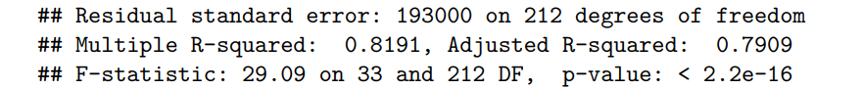
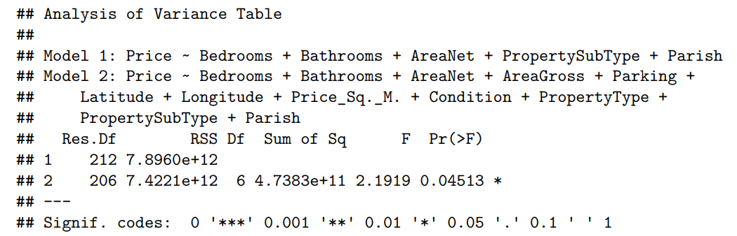
Results and Analysis of Model 1
Regression result of reduced model
Result of F-test

Slide 10
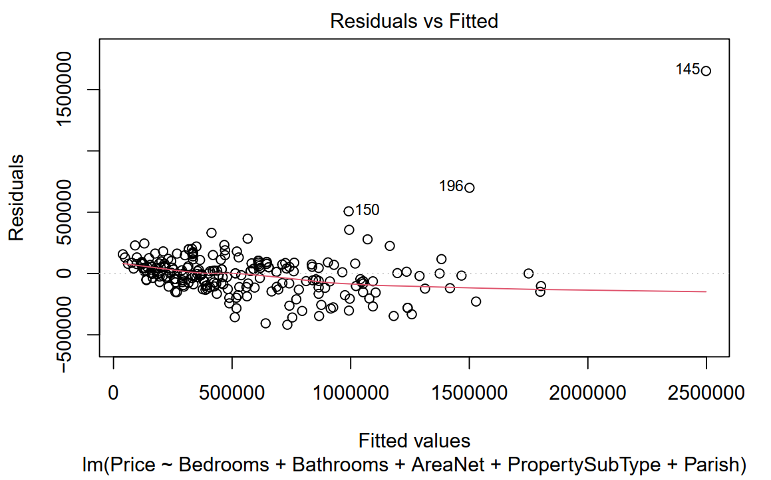
Results and Analysis of Model 1
Residual plot of Model 1

Slide 11
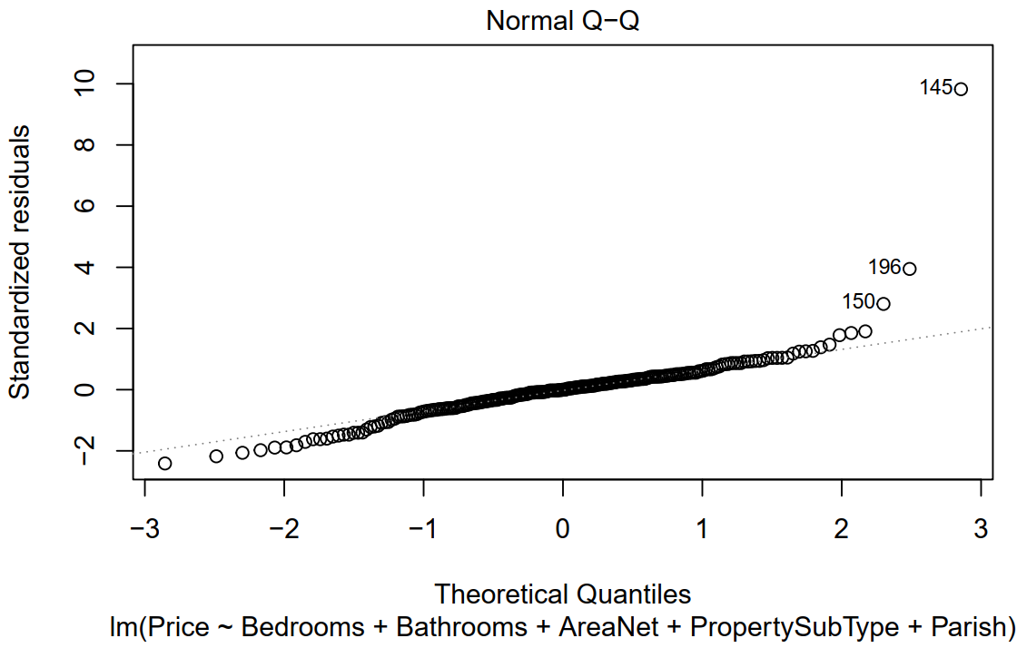
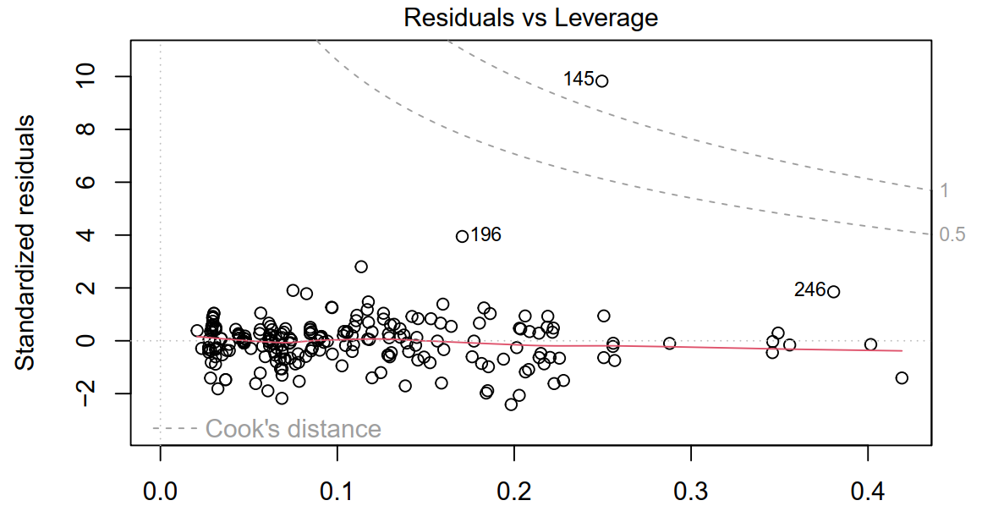
Results and Analysis of Model 1
Q-Q plot and Leverage plot of Model 1 after deleting high leverage points

Slide 12
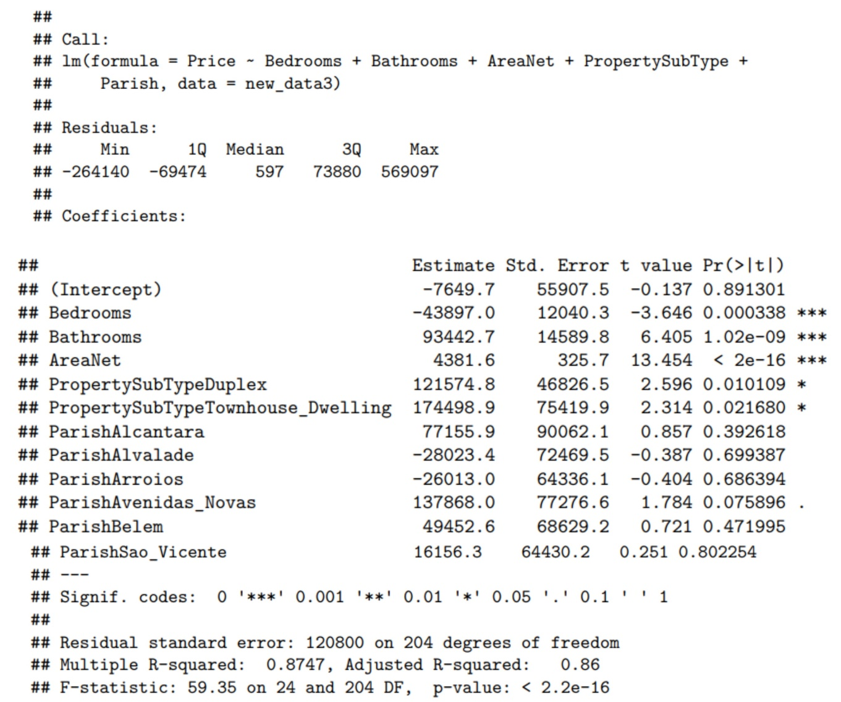
Results and Analysis of Model 1
Regression on model 1 after first deleting of outliers

Slide 13
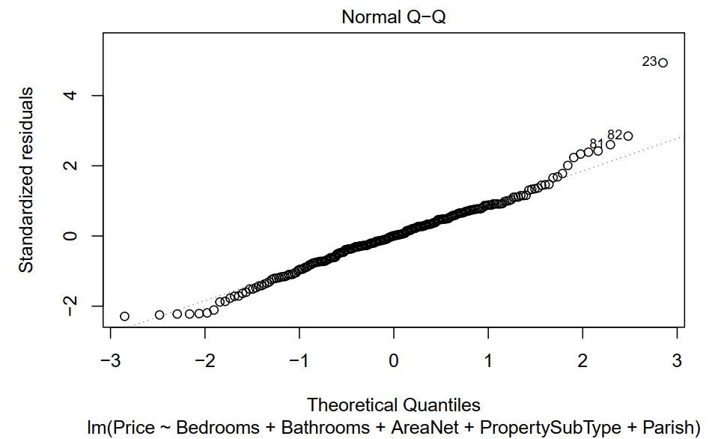
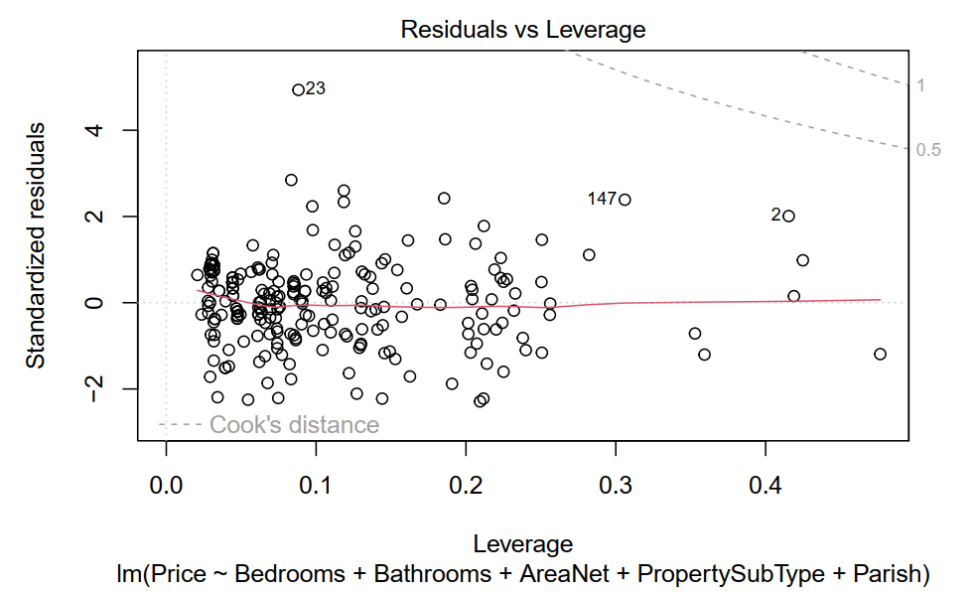
Results and Analysis of Model 1
Q-Q Plot of model 1 after first deleting of outliers

Slide 14
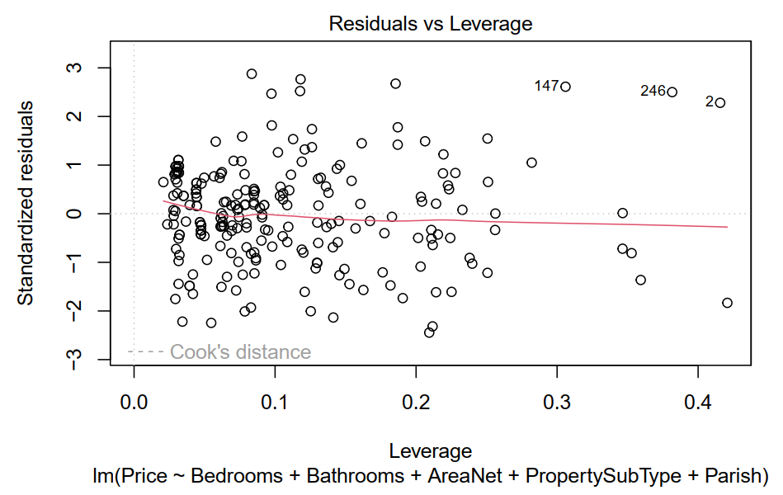
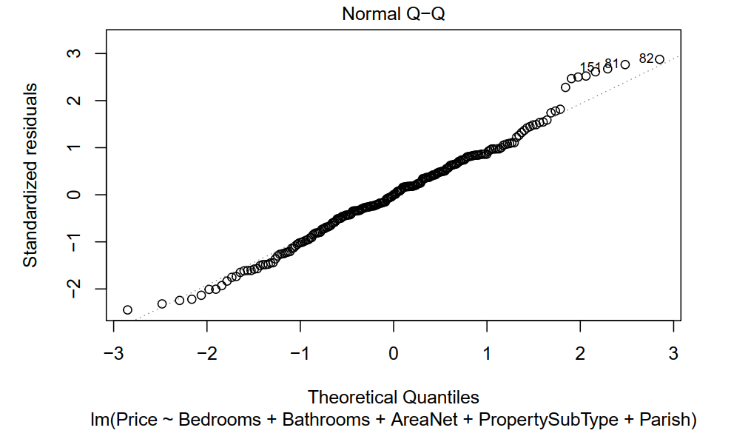
Results and Analysis of Model 1
Q-Q Plot of model 1 after second deleting of outliers

Slide 15
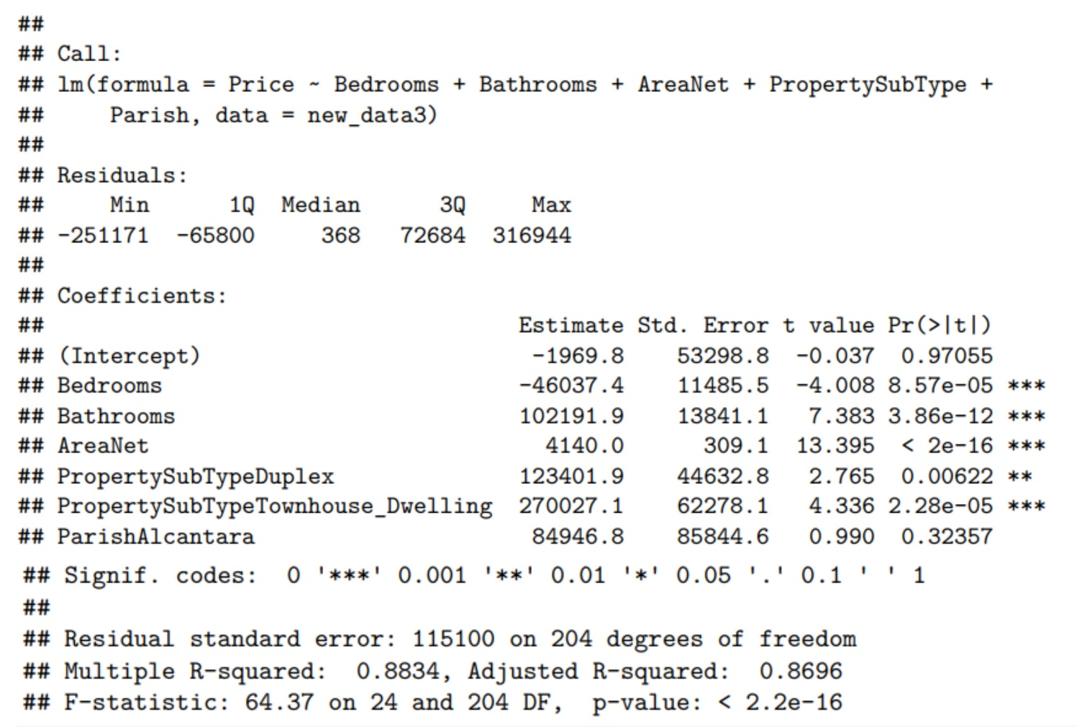
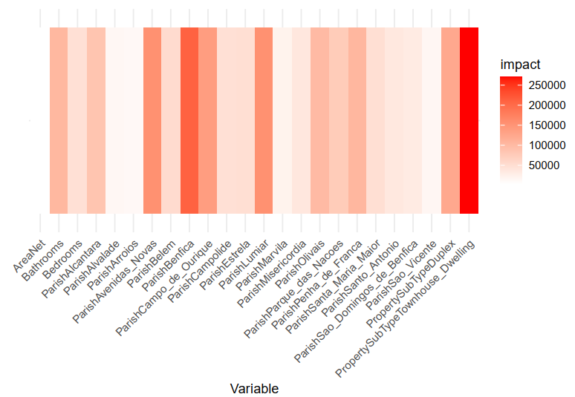
Results and Analysis of Model 1
Regression on model 1 after second deleting of outliers & Final heat map

Slide 16
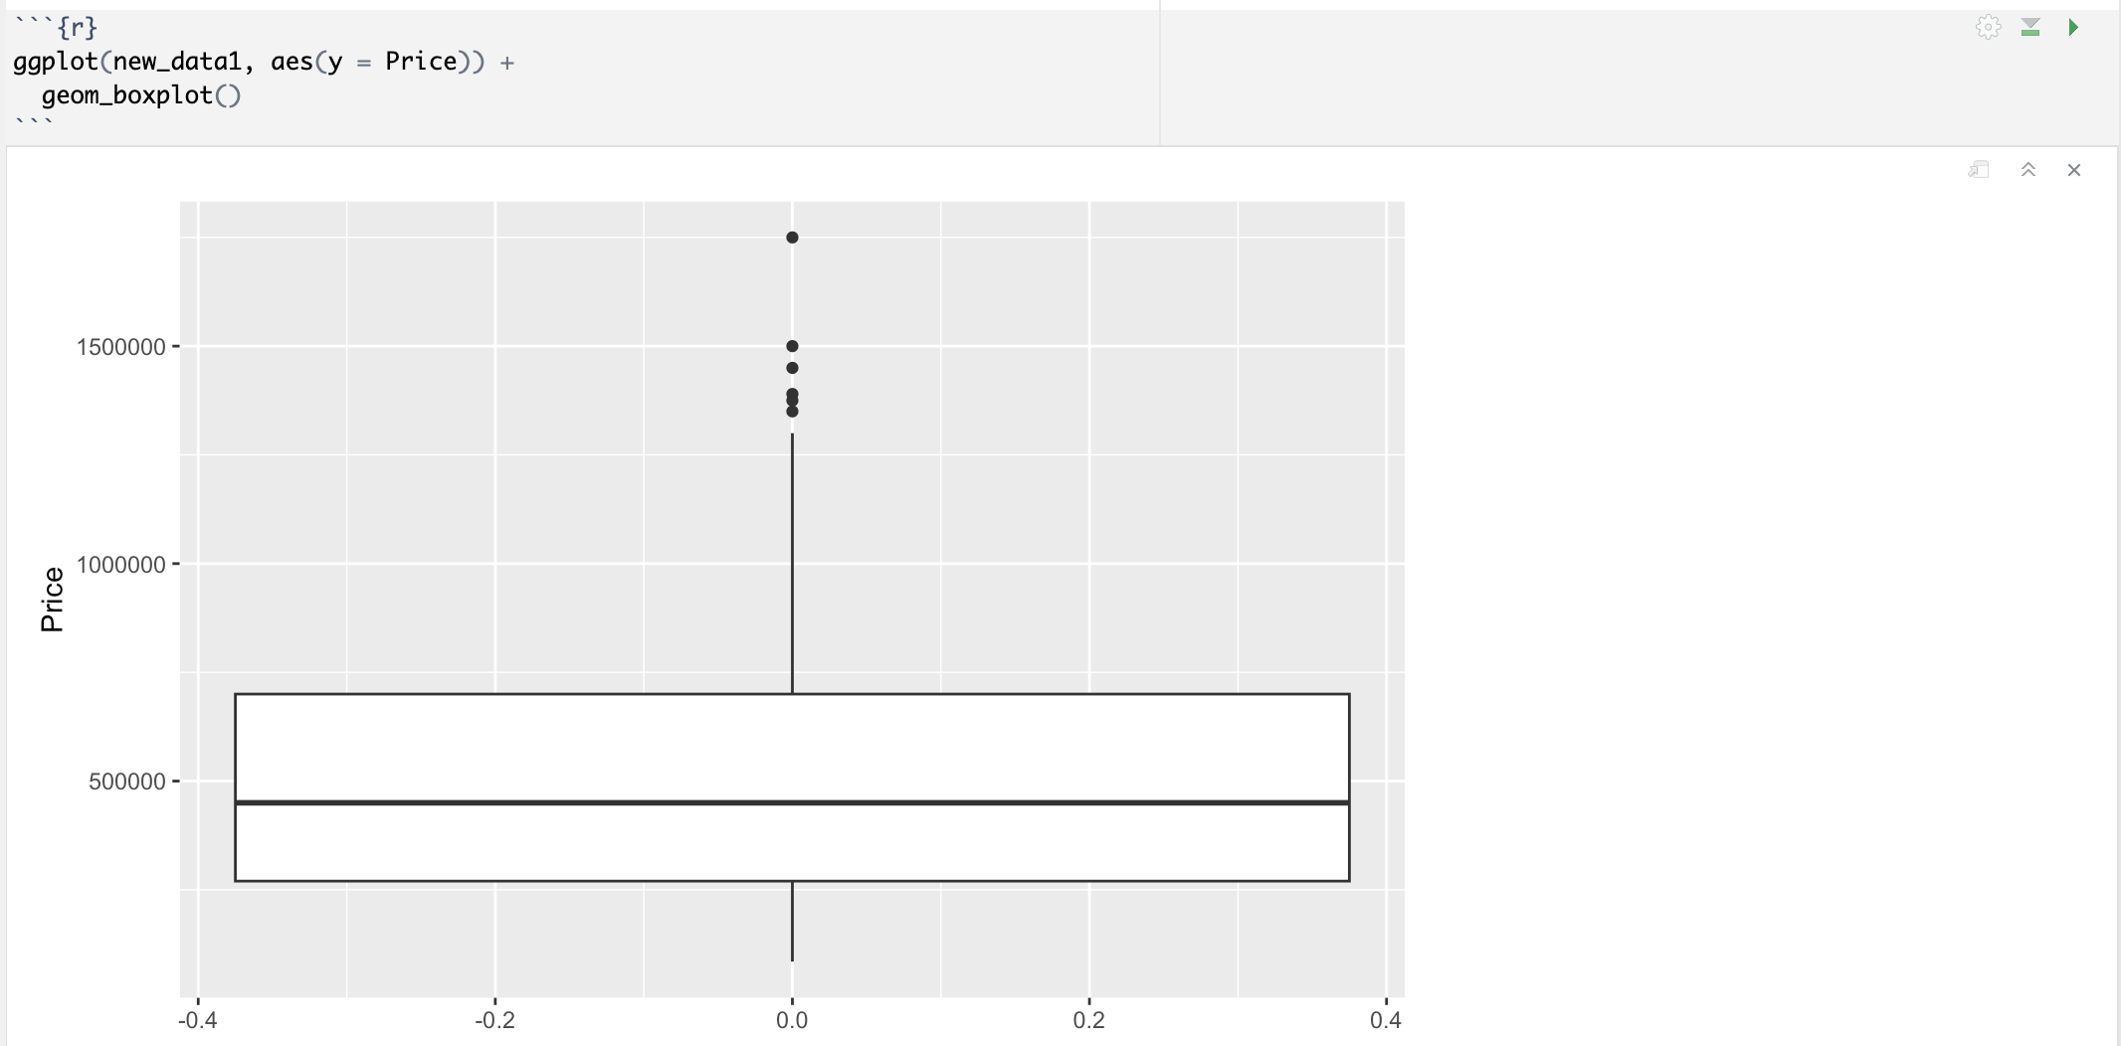
Results and Analysis of Model 2
Boxplot of Model 2

Slide 17
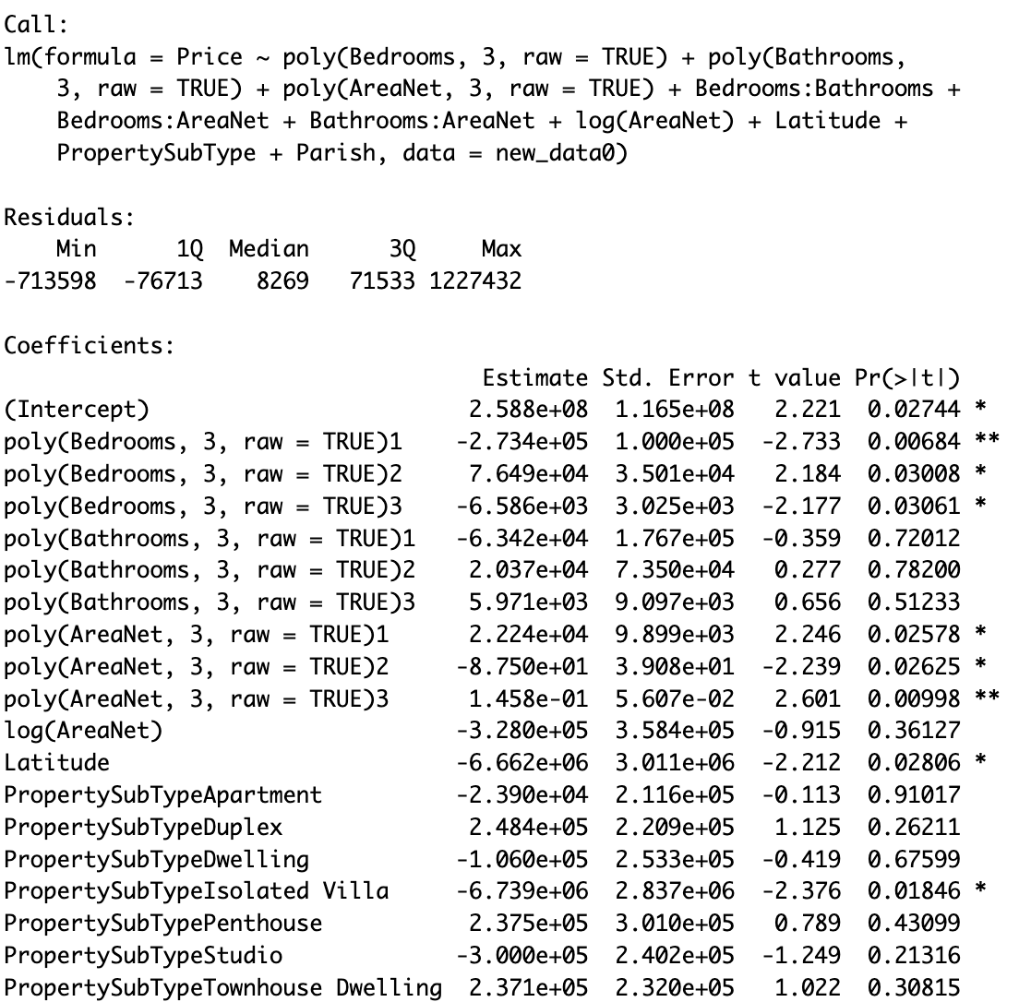
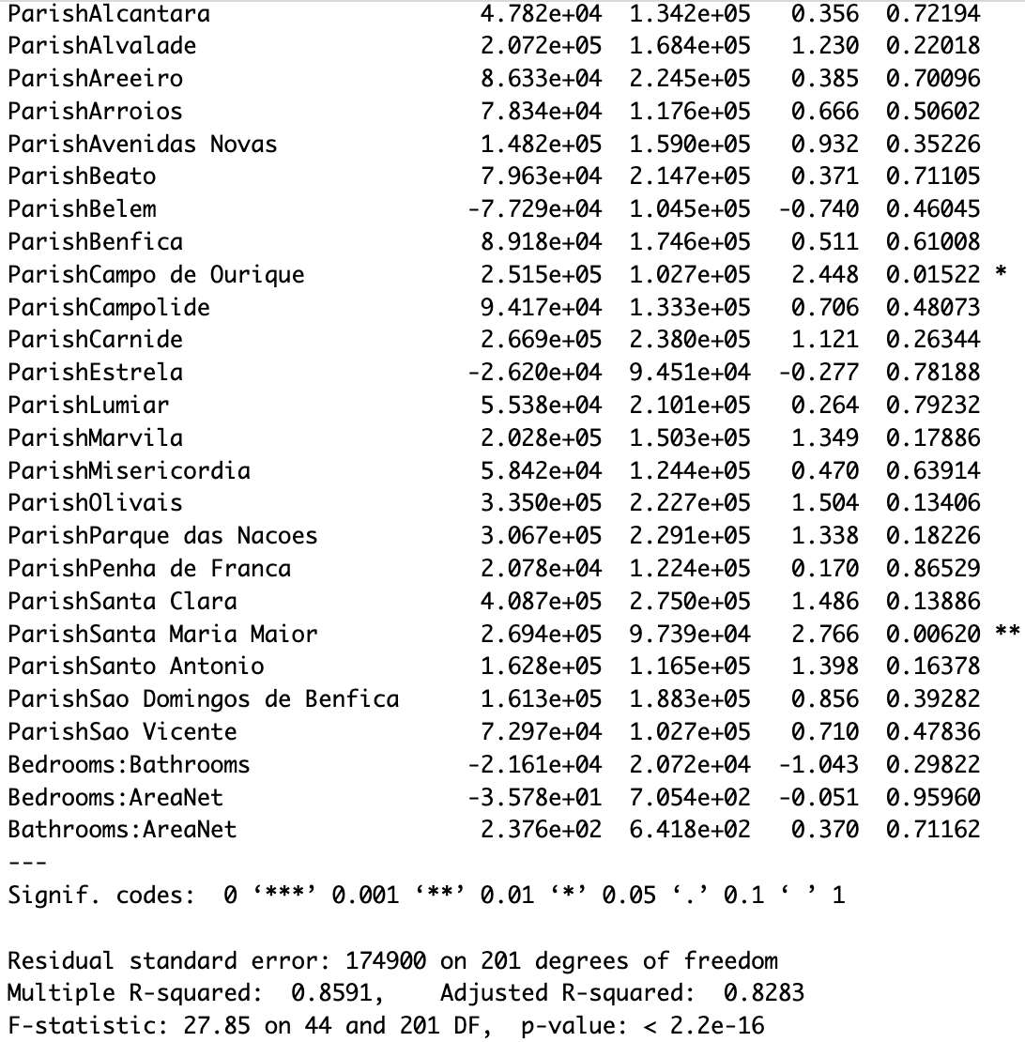
Results and Analysis of Model 2
Original regression of Model 2

Slide 18
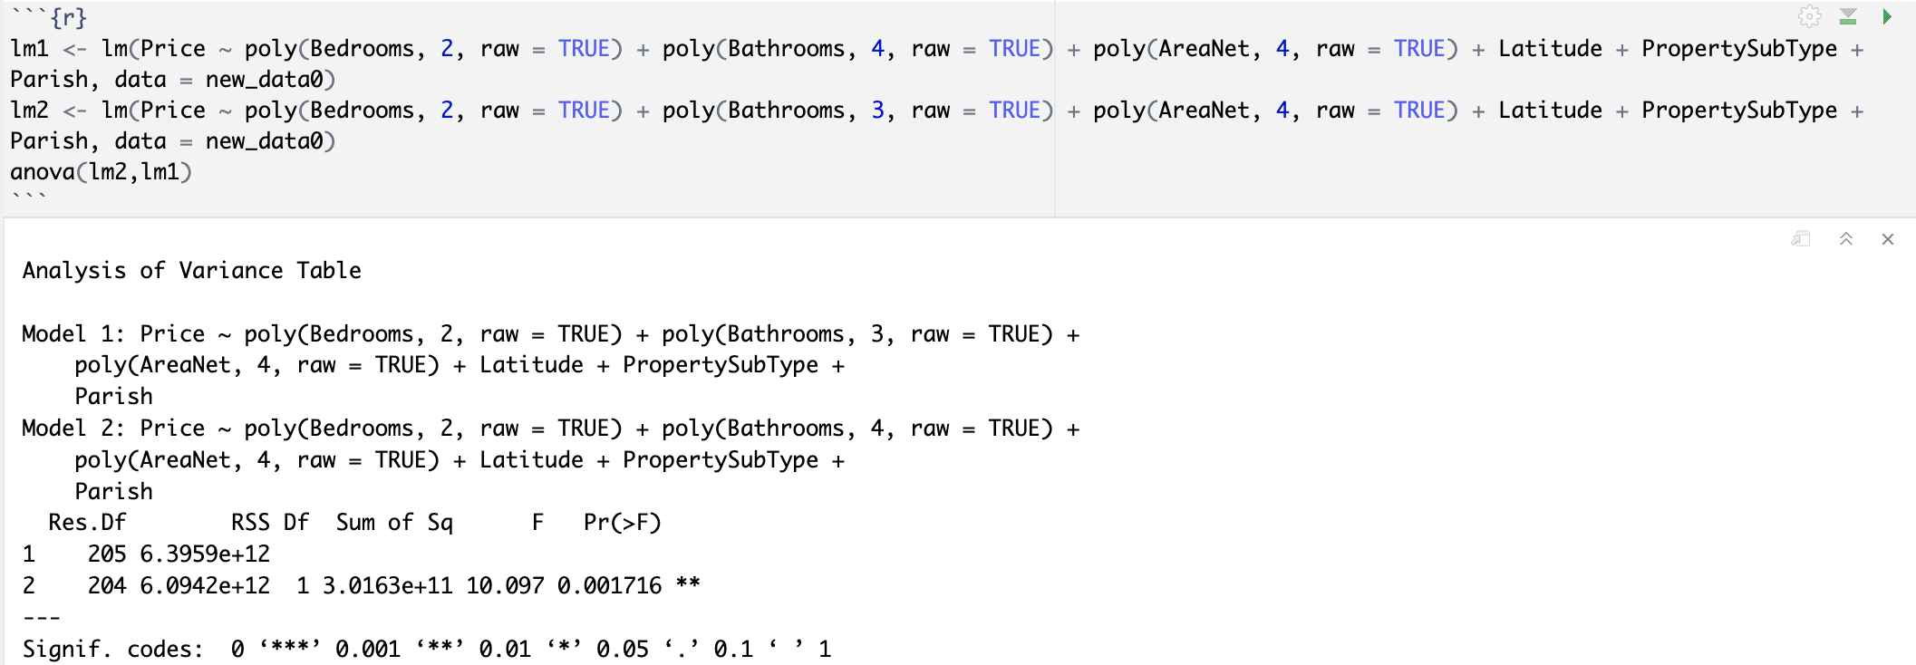
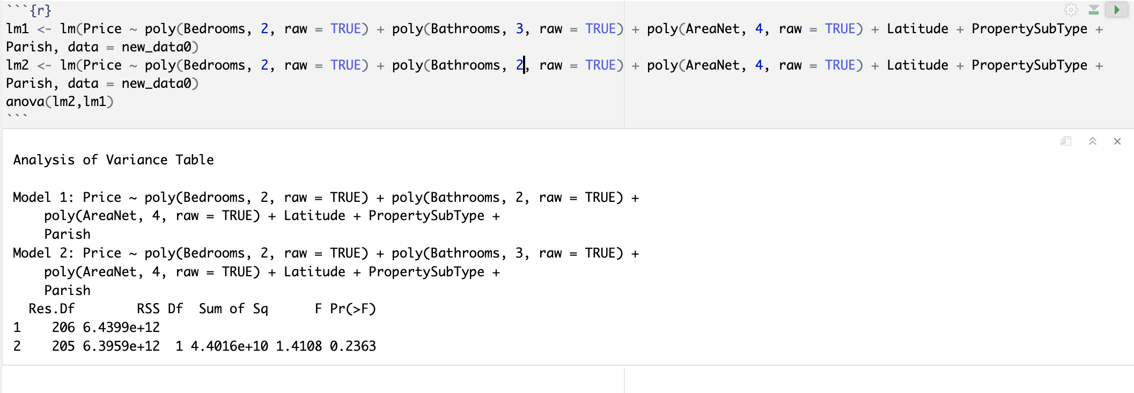
Results and Analysis of Model 2
Result of F-test to determine if to reduce the model

Slide 19
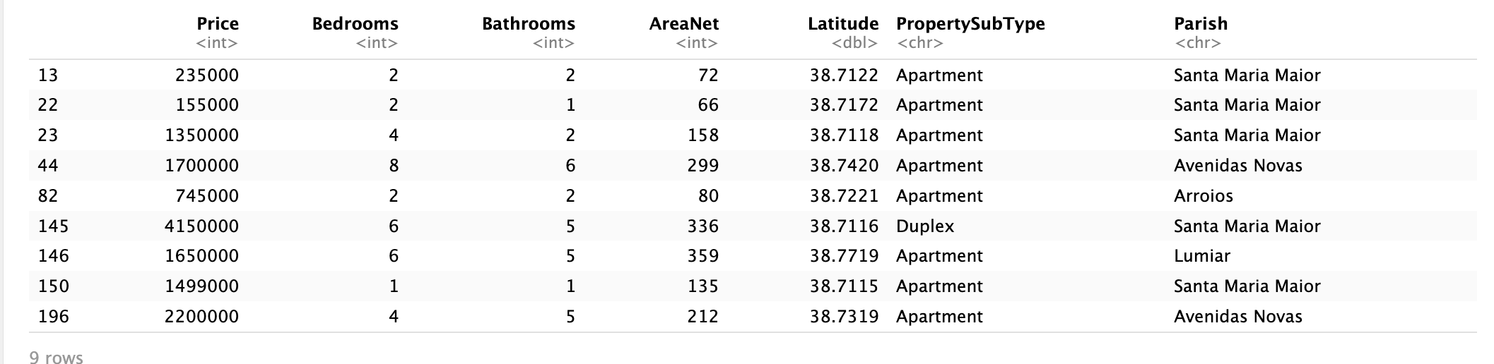
Results and Analysis of Model 2
Getting rid of outliers:

Slide 20
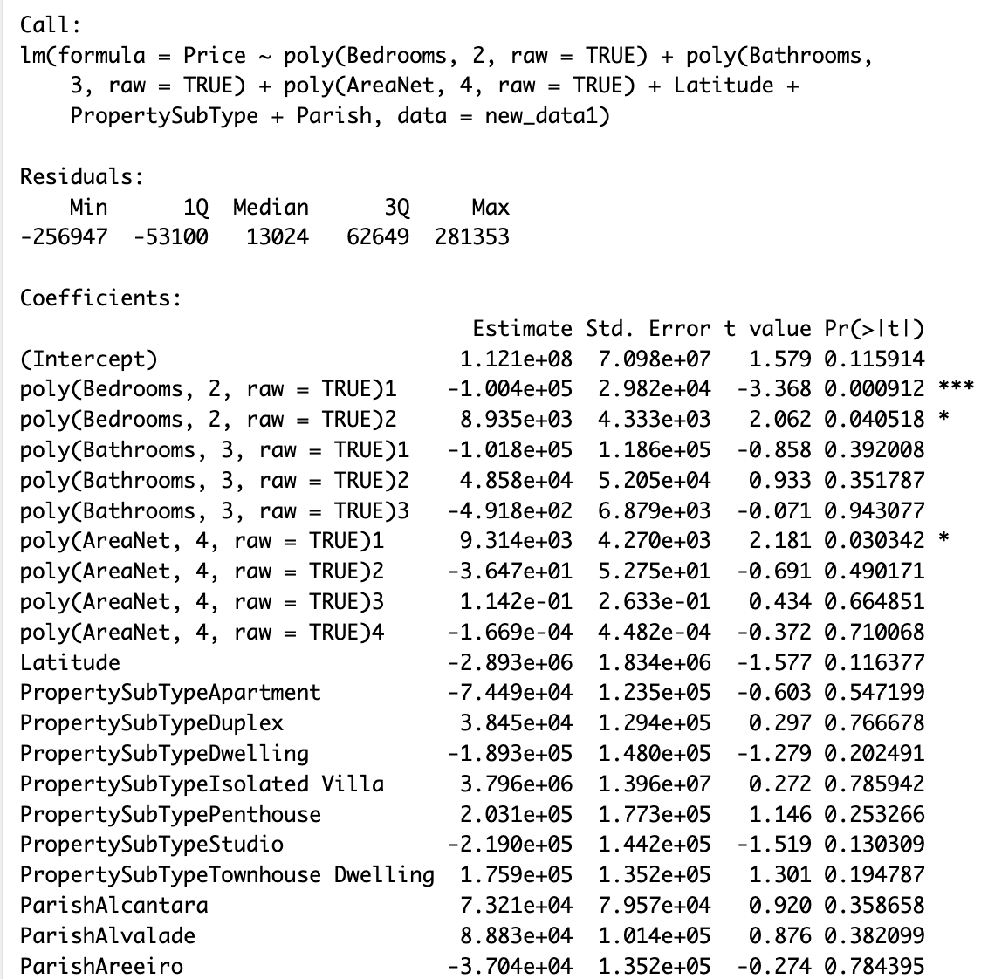
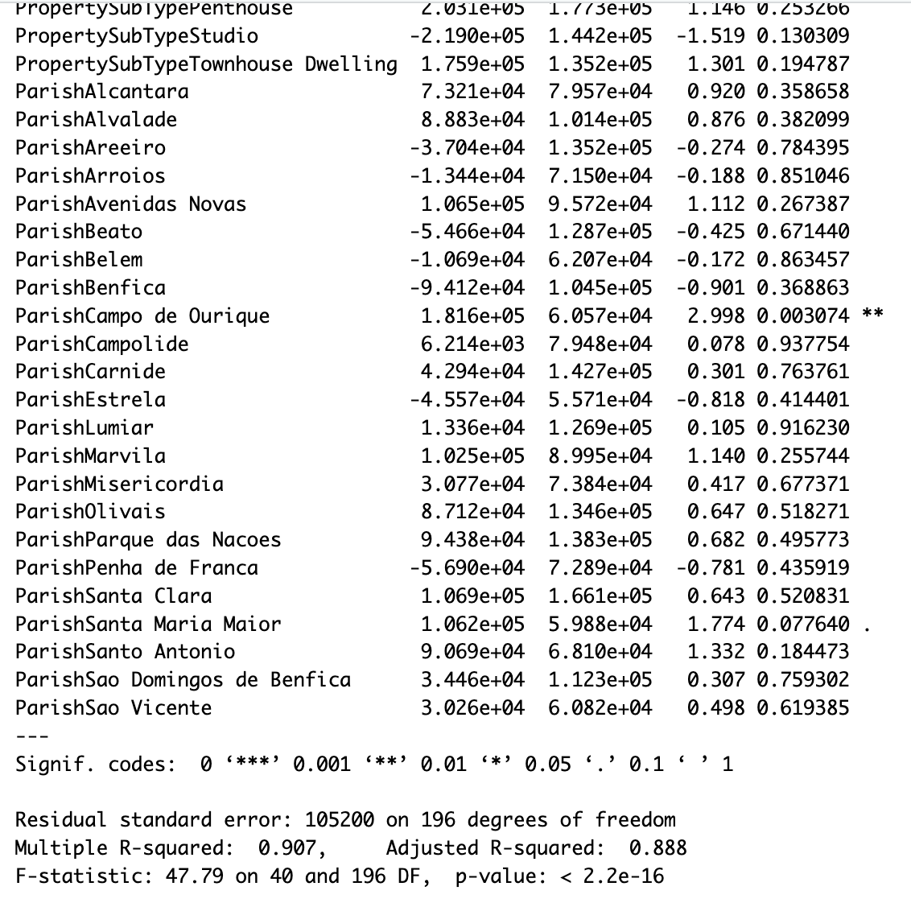
Results and Analysis of Model 2
Final regression of Model 2 after reducing variables

Slide 21
Discussion

Slide 22
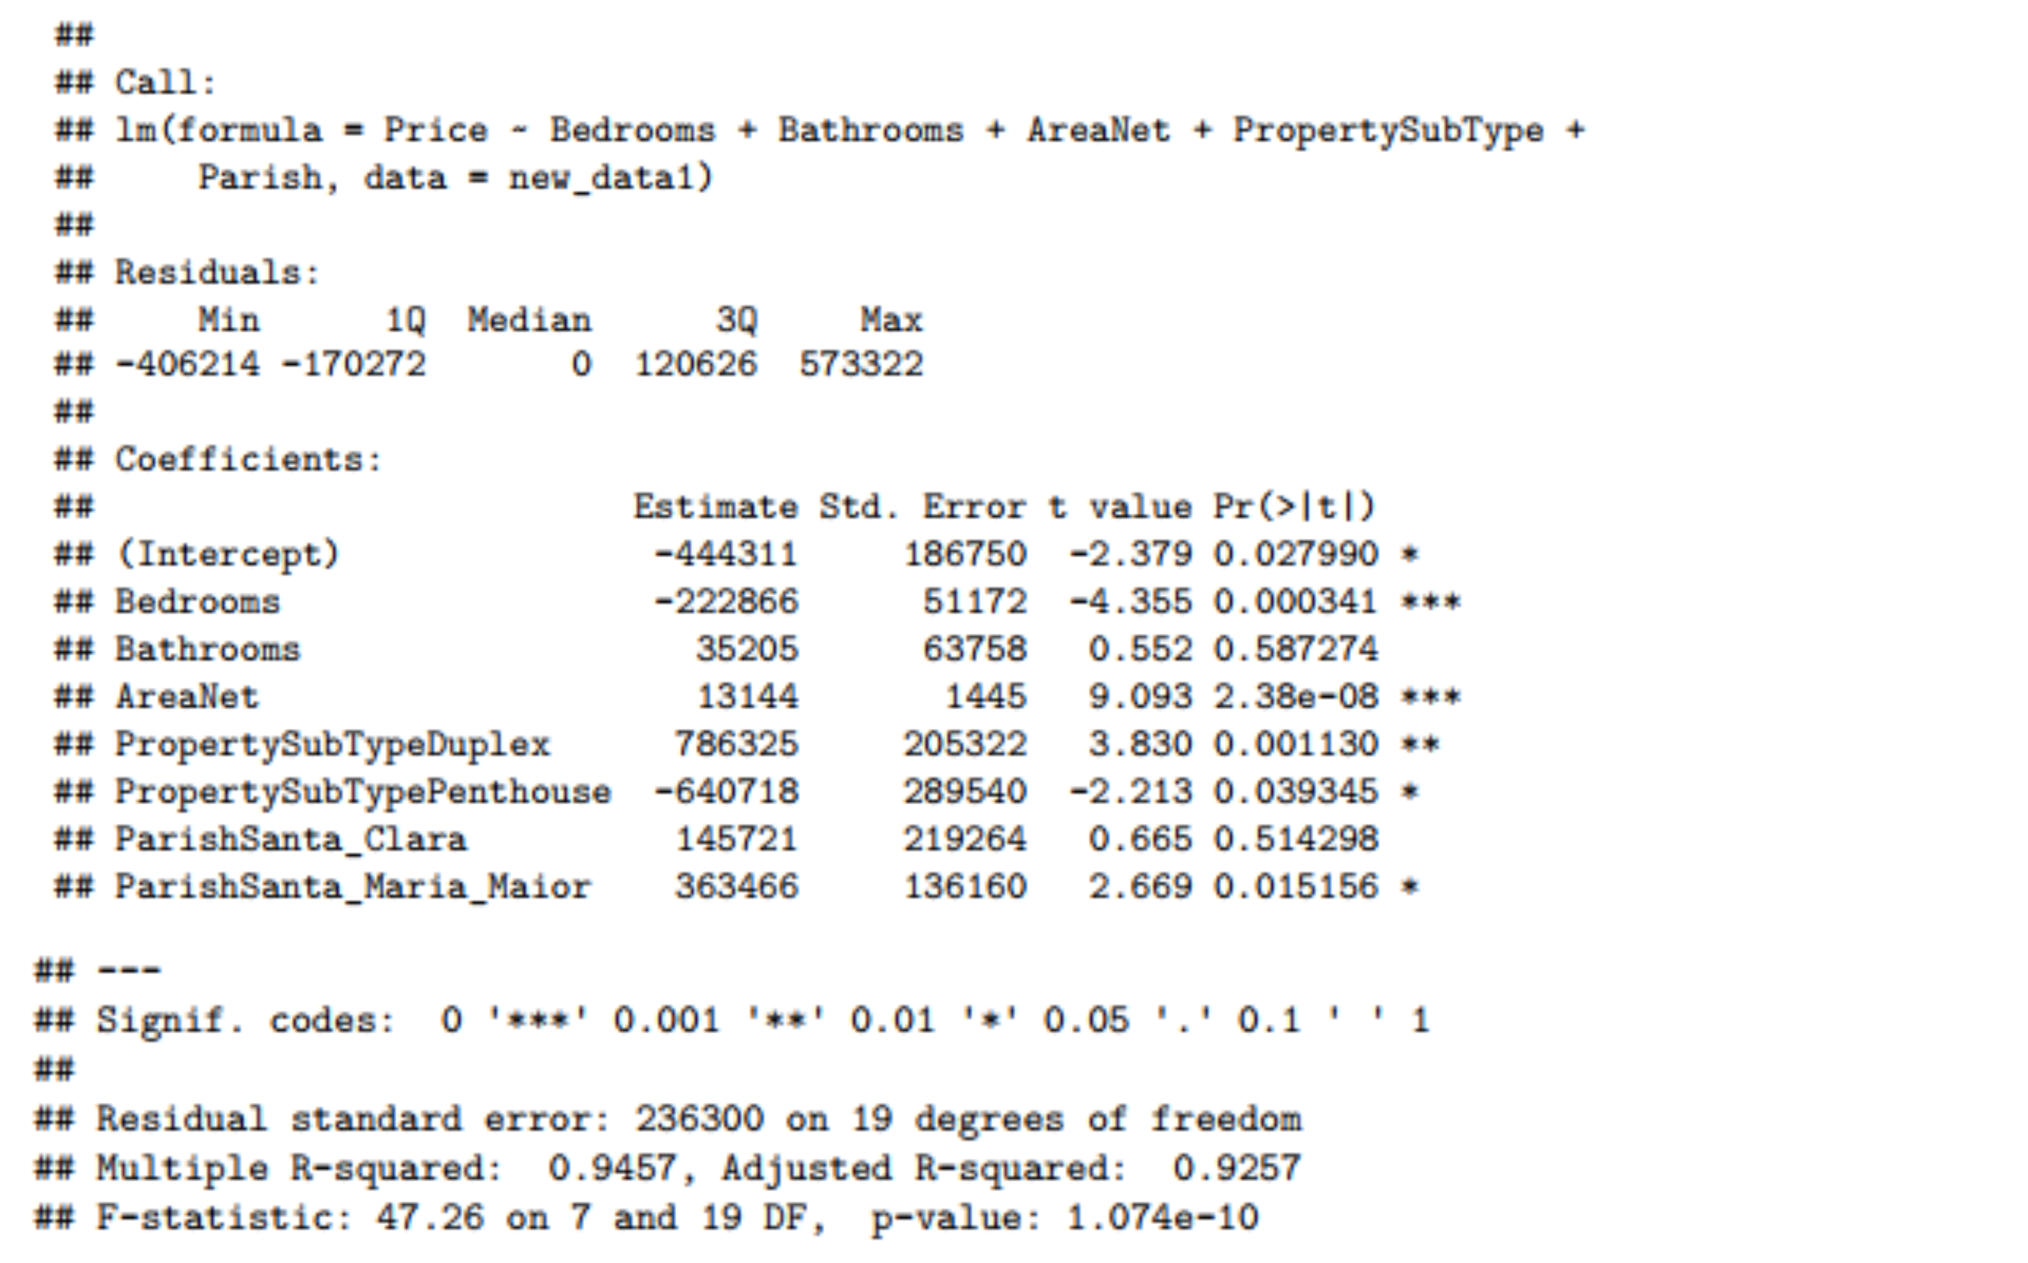
Discussion of Model 1
Although certain sub-variables like ParishAvenidas Novas exhibit significant influence on the model, we cannot selectively remove other Parish sub-variables and retain only significant ones due to potential changes in the dataset (limited to specific Parishes like Avenidas Novas or Santa Maria Maior). Consequently, this data would lose its meaningful context and impact on the analysis.

Slide 23
Discussion of Model 2
The model can be useful in predicting the price of houses in Lisbon and it shows that the price is correlated with number of bedrooms, number of bathrooms, net area, latitude and the district where the house is located in.
Model 1 shows that in order for the price to be higher, the house has to have a large area, less bedrooms, more bathrooms and be at a good place. Since number of bedrooms and bathrooms are mainly small, the result is the same for model 2.

Slide 24
Conclusions

Slide 25
Conclusion
The model can be useful in predicting the price of houses in Lisbon and it shows that the price is correlated with number of bedrooms, number of bathrooms, net area, latitude and the district where the house is located in.
Model 1 shows that in order for the price to be higher, the house has to have a large area, less bedrooms, more bathrooms and be at a good place. Since number of bedrooms and bathrooms are mainly small, the result is the same for model 2.

Slide 26

Thanks for Listening！
Notes:
我的分享就到这里，谢谢大家！

